Slide 1

Disentangling patterns of T cells
Evgeniya Lokes and Janine Berndt
16.05.2024
24S | Machine Learning with TensorFlow

Slide 2
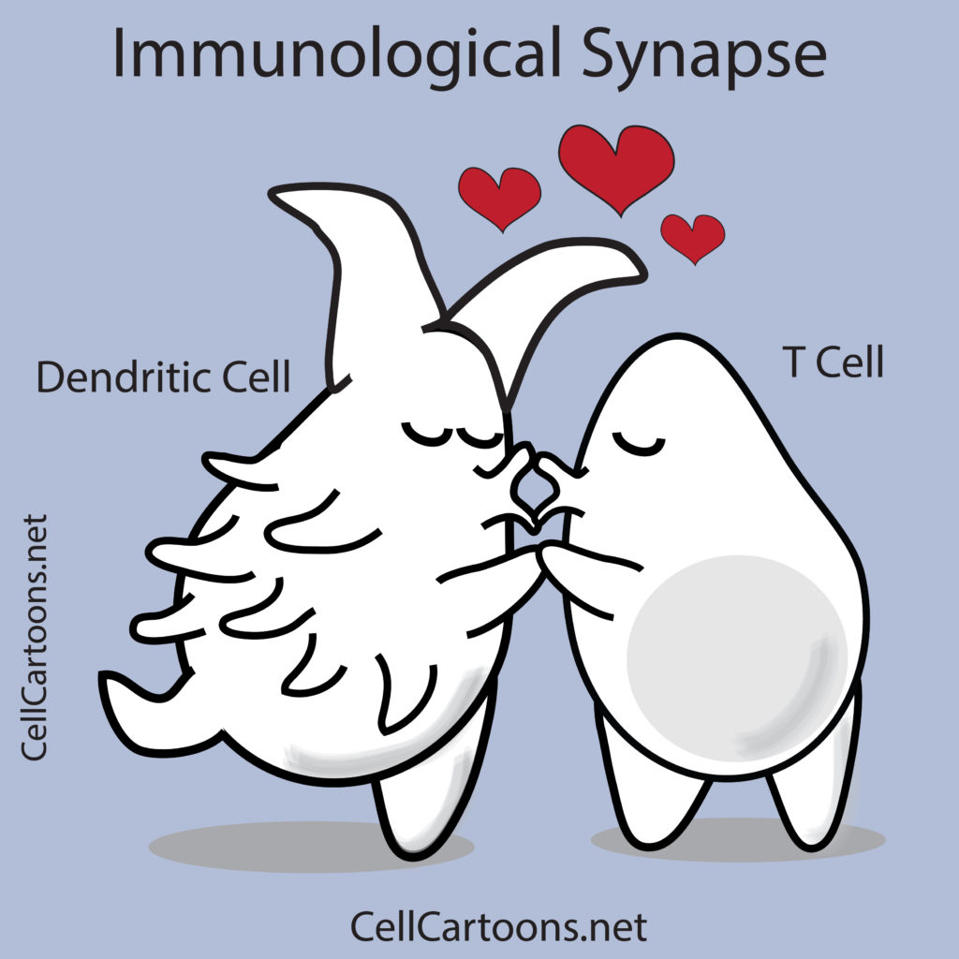
Gentle intro to T cells

Slide 3

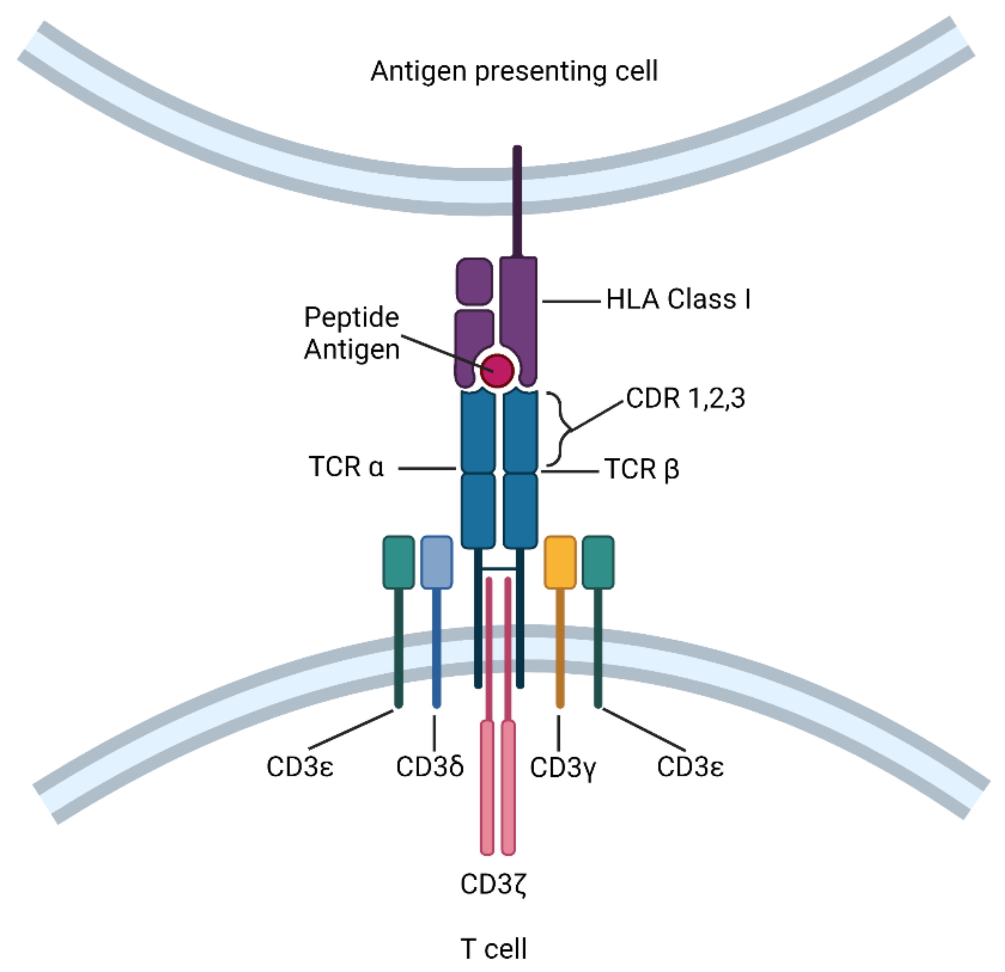
Just cells, doing their business
Randomly generated
sequences
T cell

Slide 4
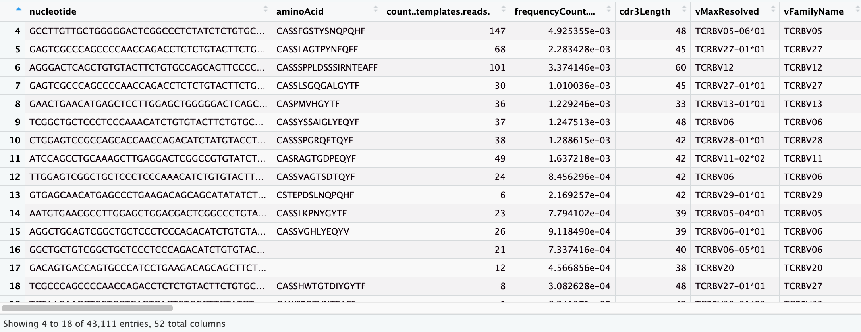
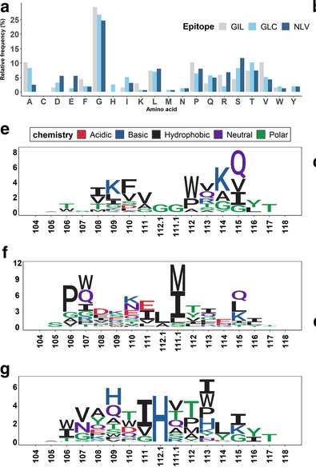
Using public datasets of T cell repertoire of patients
Each person has 10^10 sequences….a lot
Most of them are private….
Can we find patterns and predict?

Slide 5
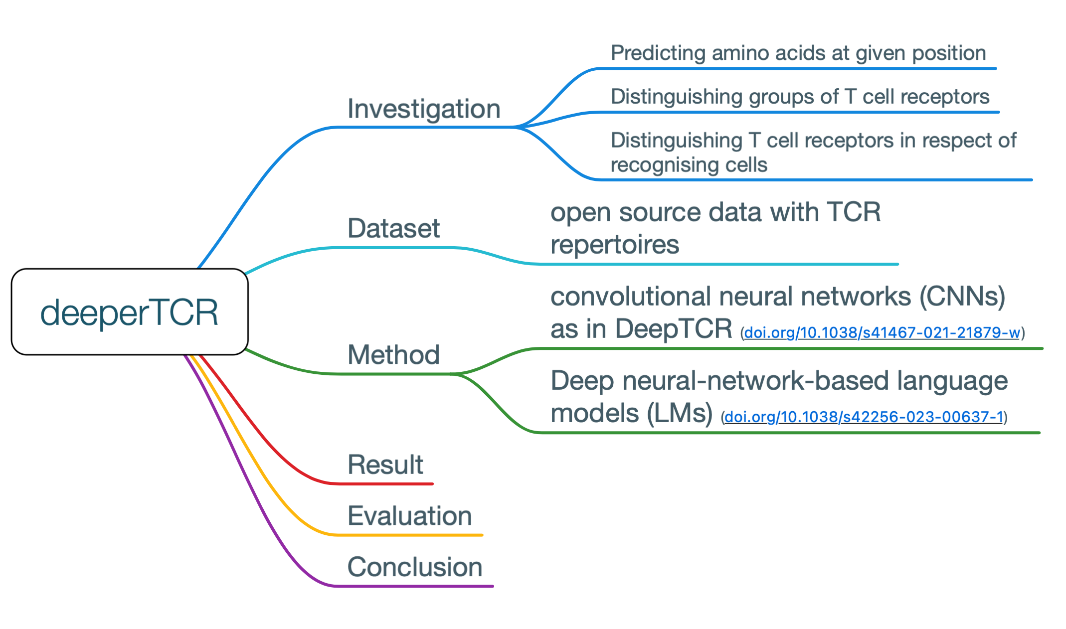
Framework

Slide 6
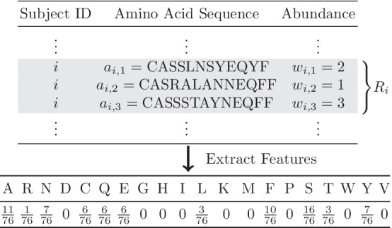
Prediction of AA at given position
S
F
R
C W
G Y
M
L
G
R
S
M
N
C
A
?
F

Slide 7
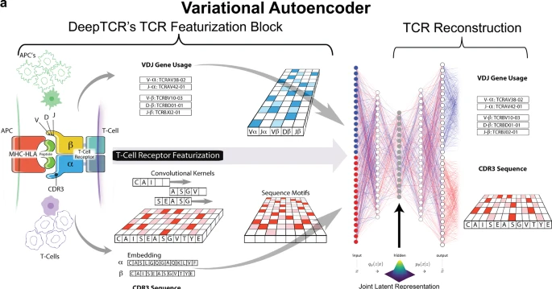
Literature review
DeepTCR is a deep learning framework for revealing sequence concepts within T-cell repertoires. John-William Sidhom, H. Benjamin Larman, Drew M. Pardoll & Alexander S. Baras. Nature Communications (2021)

Slide 8
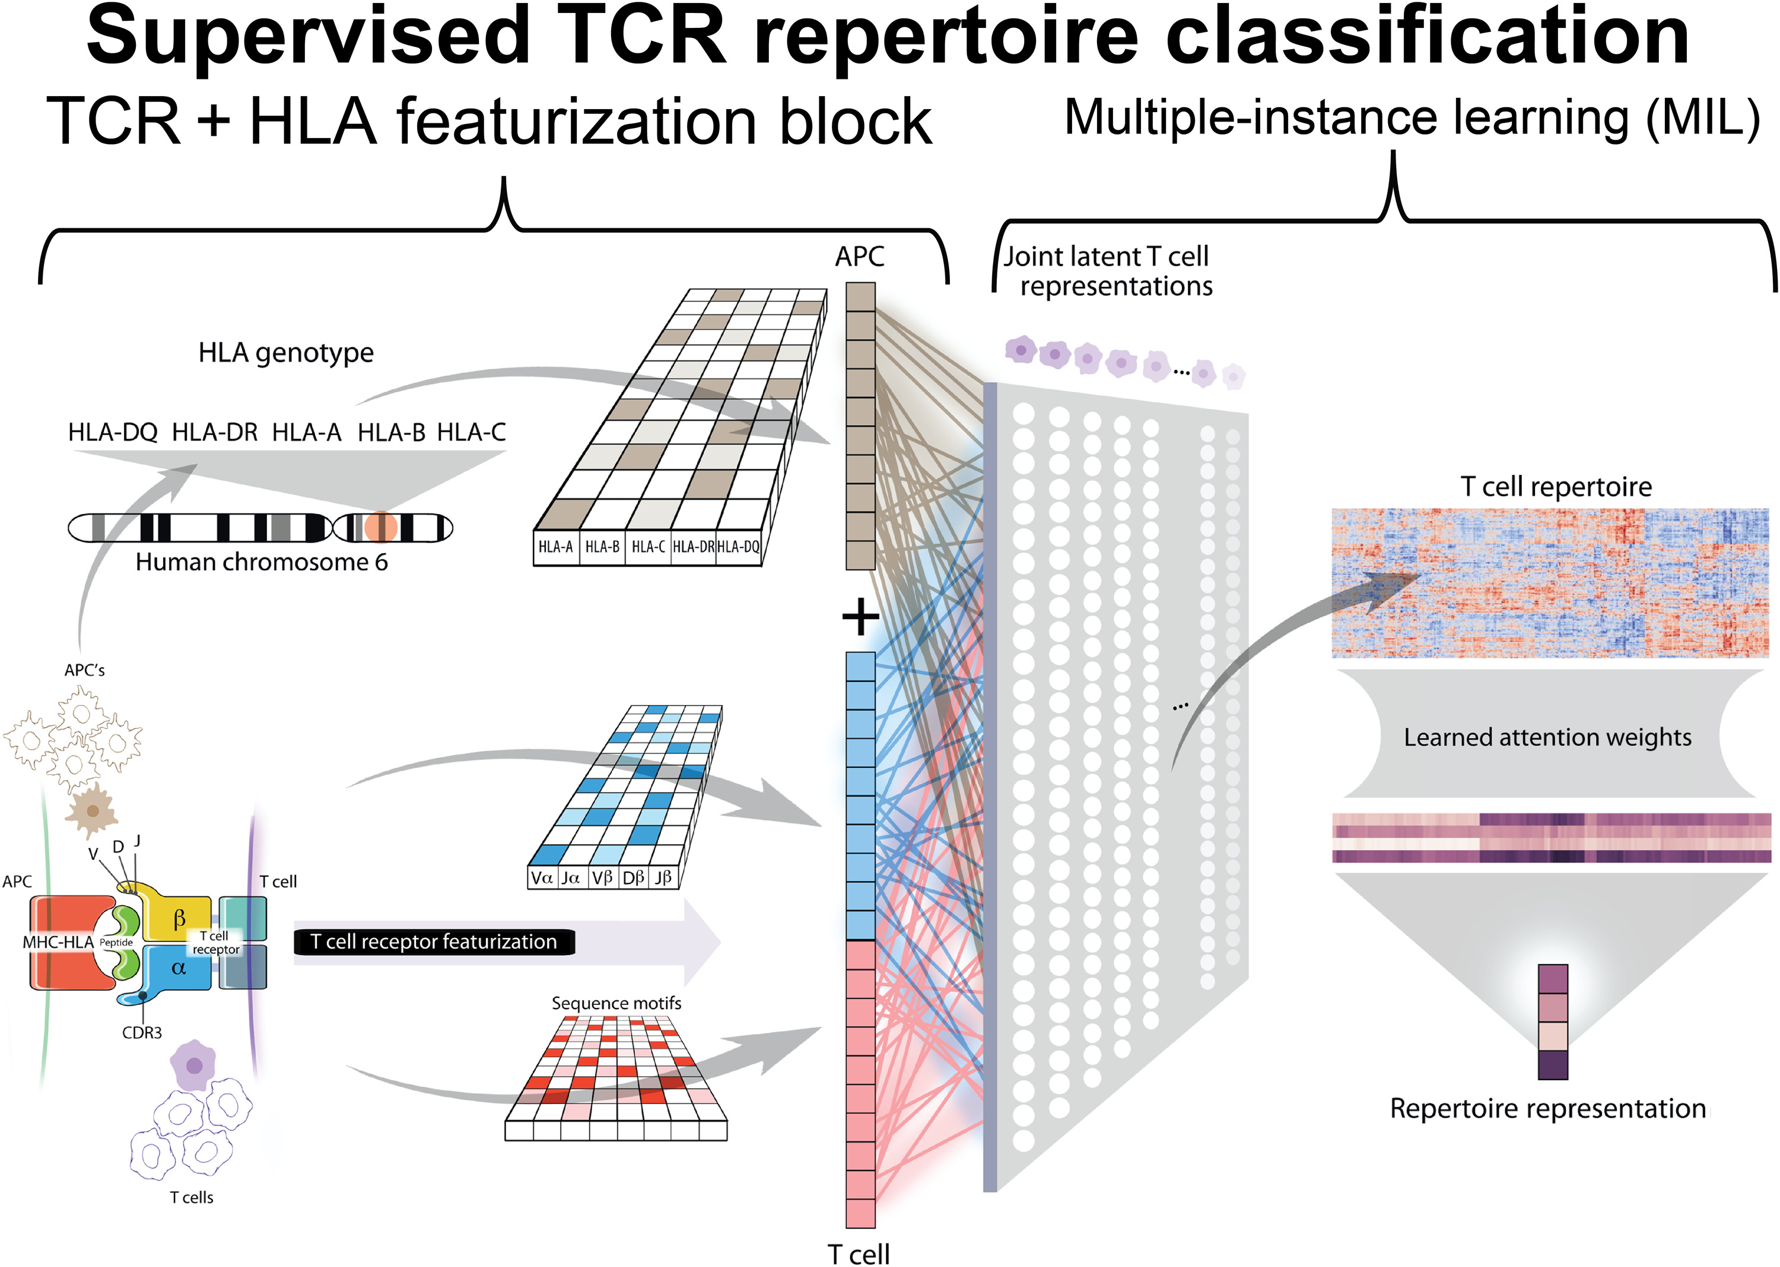

Slide 9
In order to represent a T cell receptor (TCR) we have implemented a variational autoencoder (VAE) to take the CDR3 sequences from both the α- and β-chains along with their corresponding V, D, and J gene usage and learn a joint representation of these inputs. The CDR3 sequences serve as input to the encoder side of the network where convolutional layers are then applied to learn sequence motifs from these regions. As for the V/D/J gene inputs, these are represented as categorical variables which are then transformed with a trainable embedding layer to learn a continuous representation of the gene usage of a given TCR. Finally, these inputs are concatenated together passed through fully connected layers to result in the latent representation of the TCR. This latent representation is then sampled from in order to reconstruct the input CDR3 sequences and V/D/J genes through the decoder side of the network. Finally, the weights of the neural network are trained via gradient descent to jointly minimize both the reconstruction and variational loss. The trained network is then used to take a given TCR and represent it in a continuous numerical domain for downstream analysis such as clustering. b, d In order to assess the quality of various methods of TCR featurization, we derived TCR distances from the various featurization methods (VAE-Seq, VAE-VDJ, VAE-Seq-VDJ, Hamming, K-mer, Global-Seq-Align) and applied an agglomerative clustering algorithm varying the number of clusters evenly from 5 to 100 and measured the variance ratio criterion of the clustering solutions and the adjusted mutual information from the clustering solutions to the ground truth antigen labels for both nine murine and seven human antigens. Featurization methods that encourage high-quality clusters that capture a high degree of information of the label (i.e. antigen specificity) should have a high variance ratio criterion and high adjusted mutual information. c, e In order to benchmark the ability of various methods of TCR featurization to correctly classify a TCR sequence to its antigen, we applied a K-Nearest-Neighbors instance-based classification algorithm (varying K evenly from 1 to 500, Supplementary Figs. 3–10) to the derived TCR distances on the nine murine and seven human tetramer-sorted antigen-specific T cells and assessed classification performance via fivefold cross-validation strategy, measuring AUC, Recall, Precision, and F1 Score.

Slide 10
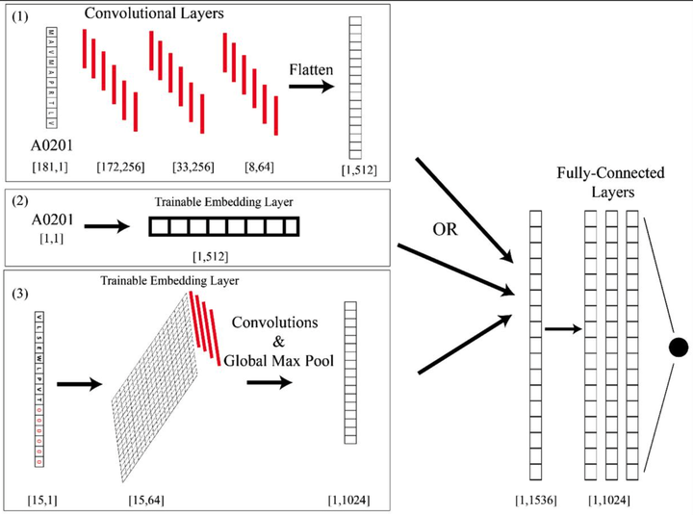

Slide 11
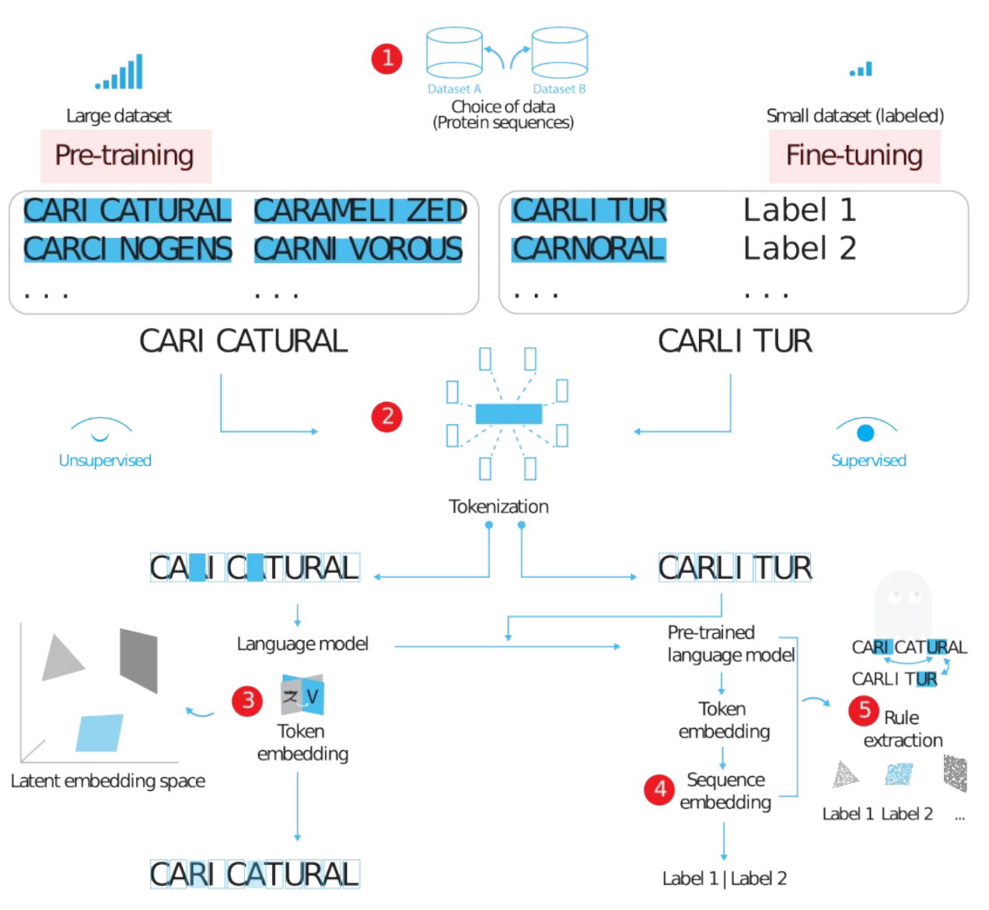
Linguistically inspired roadmap for building biologically reliable protein language models. Mai Ha Vu, Rahmad Akbar, Philippe A. Robert, Bartlomiej Swiatczak, Geir Kjetil Sandve, Victor Greiff & Dag Trygve Truslew Haug. Nature Machine Intelligence (2023)

